Slide 1

Title Slide
Site Name
Resource Mapping & Matching
DATE

Slide 2

WHY?
Resource Mapping & Matching provides a structure to effectively and
efficiently
identify
and allocate resources to support implementation
efforts.
Notes:
Different picture

Slide 3
What We Will Accomplish Together
Map Resources for Priorities
Check Alignment
Confirm Resource Matching

Slide 4





School & District Vision

Slide 5
SWIFT Resource Mapping Forms
Notes:
What are considered resources?
In-district trainers or model teachers
State trainers
State Professional Development offerings
People, services, or materials that are available through State or National organizations
National services through Technical Assistance Centers or private organizations

Slide 6
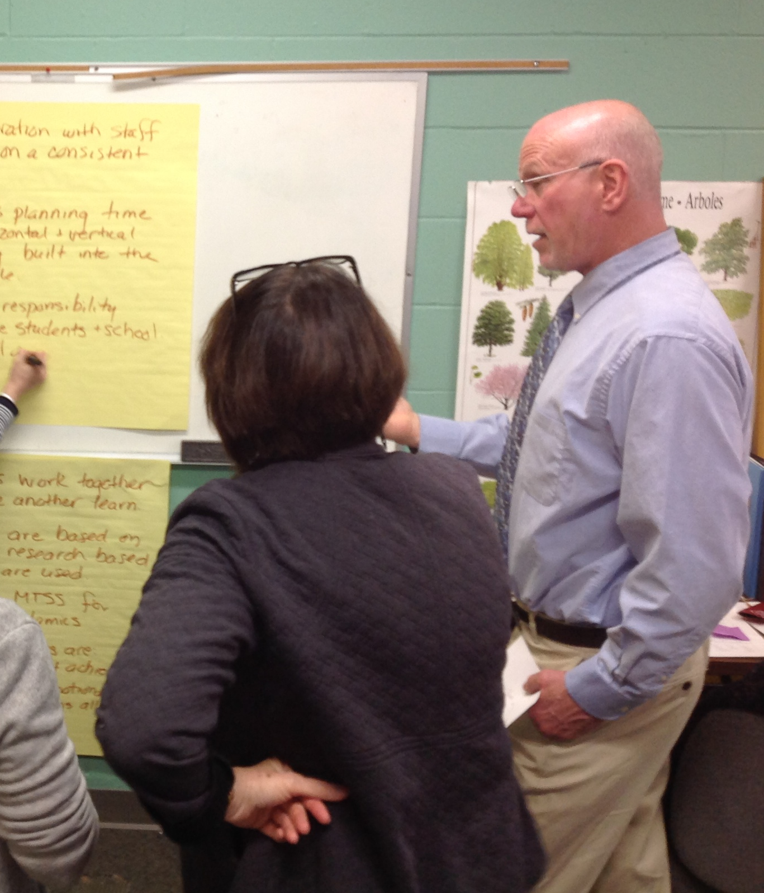
Norms
&
Roles
Notes:
Review Norms:
In what ways do we need to conduct ourselves in order for us to be most productive and engaged in this work?
Review or create roles:
Note Taker
Timekeeper?
Observer?
Jargon buster?

Slide 7
MAP RESOURCES FOR PRIORITIES

Slide 8
SWIFT Resource Mapping Form 1
Notes:
What do we know exists related to each identified priority?
Generate possibilities.
Refrain from evaluating.
Capitalize on collective knowledge of in-district, in-state, and national resources.

Slide 9
SWIFT Resource Mapping Form 2
Notes:
What do we know exists related to each identified priority?
Generate possibilities.
Refrain from evaluating.
Capitalize on collective knowledge of in-district, in-state, and national resources.

Slide 10
CHECK ALIGNMENT

Slide 11
Do the potential resources align with the vision for this priority?
Will they meet our need?
Reflect.
Ask questions for clarification or exploration.
Discuss.

Slide 12
CONFIRM RESOURCE MATCHING

Slide 13
Current Reality
Highlight resources selected.
Capture any notes that represent details, enhancements, or follow-up actions.
Which resources will be matched to which priorities?
swiftschools.org

Slide 14
NEXT STEPS & WRAP UP

Slide 15
Summarize & Next Steps
Distribution of completed Resource Mapping & Matching form
  Timeline:
Distribution of notes
  Timeline:
Review resource status at next State, District, or Building Team meeting
  Next Team Meeting:

Slide 16
Process the Meeting
What worked?
Didn’t work – Enhancements for the Future?

Slide 17

Final Slide
SWIFT Center produced this presentation under U.S. Department of Education, Office of Special Education Programs Grant No. H326Y120005. OSEP Project Officers Grace Zamora Durán and Tina Diamond served as the project officers. The views expressed herein do not necessarily represent the positions or policies of the Department of Education. No official endorsement by the U.S. Department of Education of any product, commodity, service or enterprise mentioned in this publication is intended or should be inferred. This product is public domain. Authorization to reproduce it in whole or in part is granted. Please cite as: Presenter, A.A.. (Year, Month). Resource Mapping & Matching. Presented at Organization, Location.

