Slide 1

Site Name
Priorities
DATE

Slide 2

WHY?
Priority & Practice Planning
prompts important conversations about
the current stage of implementation for an educational
practice and
identifies steps needed to achieve sustainable use of the practice.

Slide 3
Priority & Practice Planning is the process teams use to develop and monitor transformative action plans.
PRIORITY
is an opportunity identified by the team
in order to achieve their vision
PRACTICE
is a purposefully selected intervention, action,
or collection of activities that leads to the accomplishment of the priority
Notes:
With a few priorities identified, the next practice we engage is Priority and Practice Planning— definitions…

Slide 4
What We Will Accomplish Together
Identify Entry Point
Consider Options
Form the Plan

Slide 5





School & District Vision

Slide 6
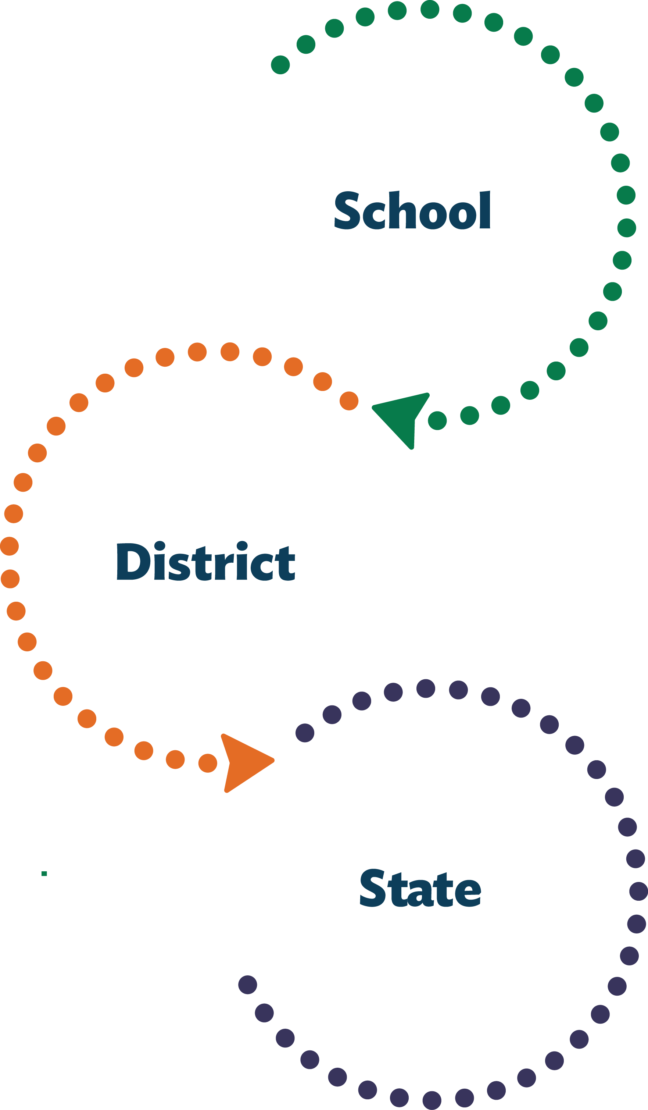
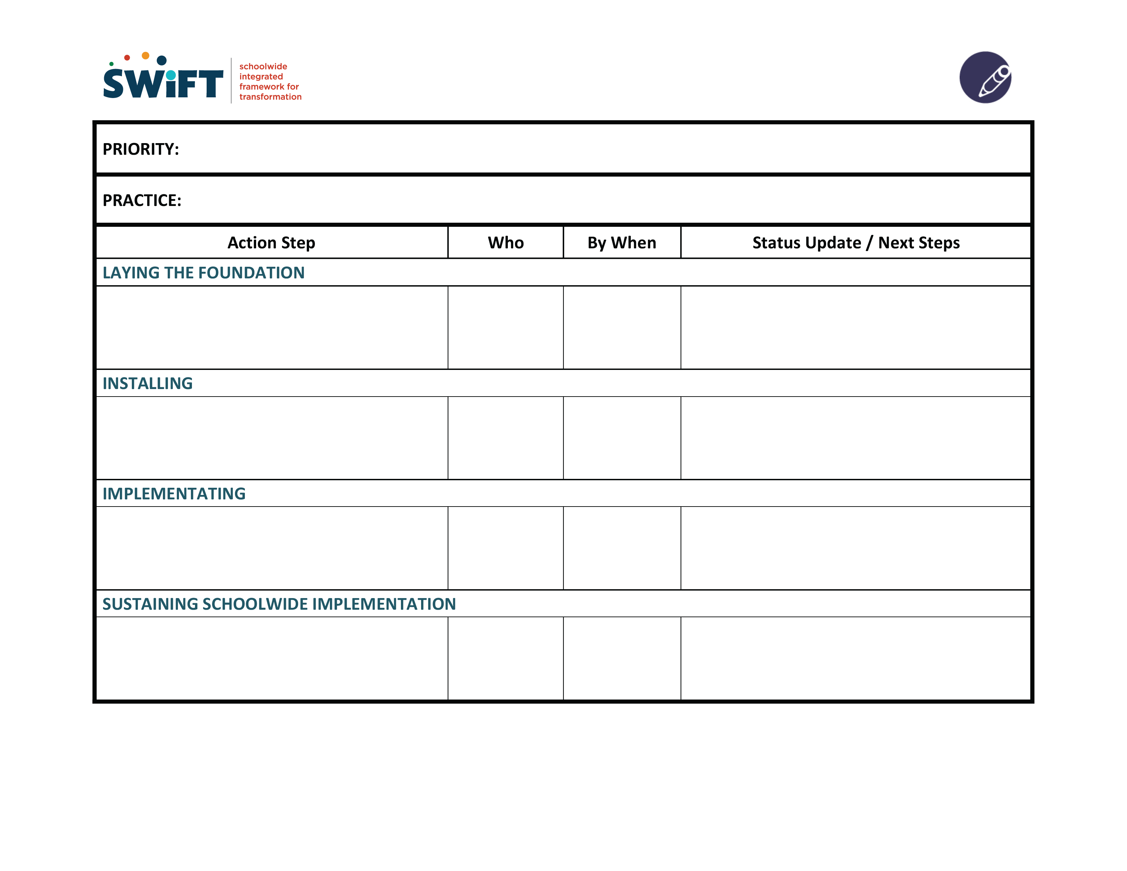
Priority & Practice Planning Form

Slide 7
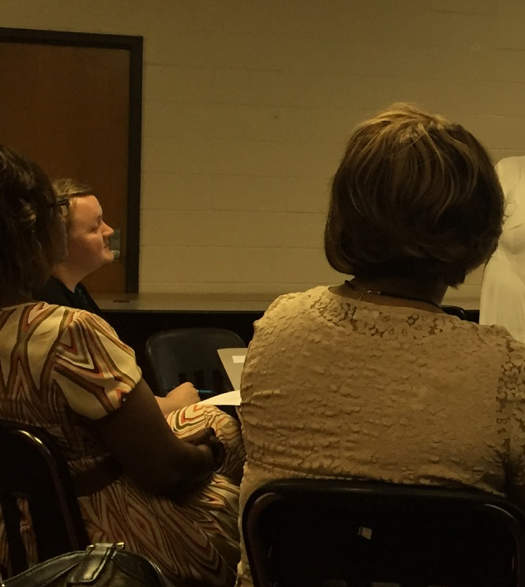
Norms
&
Roles
Notes:
Review Norms:
In what ways do we need to conduct ourselves in order for us to be most productive and engaged in this work?
Review or create roles:
Note Taker
Timekeeper?
Observer?
Jargon buster?

Slide 8
IDENTIFY ENTRY POINT
swiftschools.org

Slide 9
Priority and Practice Planning
Notes:
We assess where we are in terms of stages of implementation on a given practice... You have this guide as a handout.

Slide 10
For Each Statement
Prompt Answer: YES or NO
We know what options (practices) exist for this priority.
We agree on which practice we want to implement.
We have people and systems prepared to implement this practice.
We have well-trained people who will be trying-out this practice.
We have tried-out this practice.
We have reflected on initial implementation efforts and recommended improvements in the practice and systems that support it.
We have student and system outcomes that show this practice is working.
We have a competent, organized, well led system for this practice.
Notes:
Answer each prompt in order, 1-8. The first prompt to which the answer is “NO” is a likely entry point for action planning for this Practice.

Slide 11
CONSIDER OPTIONS

Slide 12
Priority and Practice Planning Quick Guide

Slide 13
Priority and Practice Planning Quick Guide 2

Slide 14
FORM THE PLAN

Slide 15
Priority and Practice Planning Screenshot
Notes:
To download fillable form, click on the hyperlink encoded in the image,
Or download in advance from http://www.swiftschools.org/sites/default/files/PPPUseItForm.pdf

Slide 16
WRAP UP

Slide 17
WRAP UP
Distribution of completed PPP Action Plan
  Timeline:
Review plan status at next District or Building Team meeting
  Next Team Meeting

Slide 18
Process the Meeting
What worked?
Didn’t work – Enhancements for the Future?

Slide 19

Final Slide
SWIFT Center produced this presentation under U.S. Department of Education, Office of Special Education Programs Grant No. H326Y120005. OSEP Project Officers Grace Zamora Durán and Tina Diamond served as the project officers. The views expressed herein do not necessarily represent the positions or policies of the Department of Education. No official endorsement by the U.S. Department of Education of any product, commodity, service or enterprise mentioned in this publication is intended or should be inferred. This product is public domain. Authorization to reproduce it in whole or in part is granted. Please cite as: Presenter, A.A.. (Year, Month). Priority & Practice Planning. Presented at Organization, Location.

