Slide 1

Title Slide
Site Name
Data Snapshots
Date

Slide 2
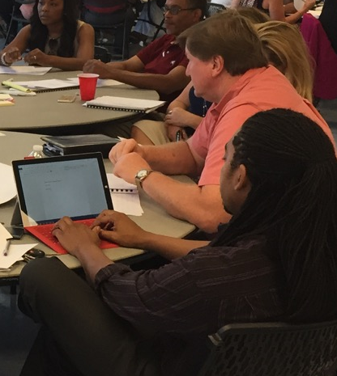
WHY?
Data Snapshots engage education leaders in a concentrated analysis of what they do, how they do it, and
the impact it has on student outcomes.

Slide 3
What We Will Accomplish Together
Reach a Shared Understanding of Current Reality
Establish Student Outcome Goals
Determine Priorities

Slide 4
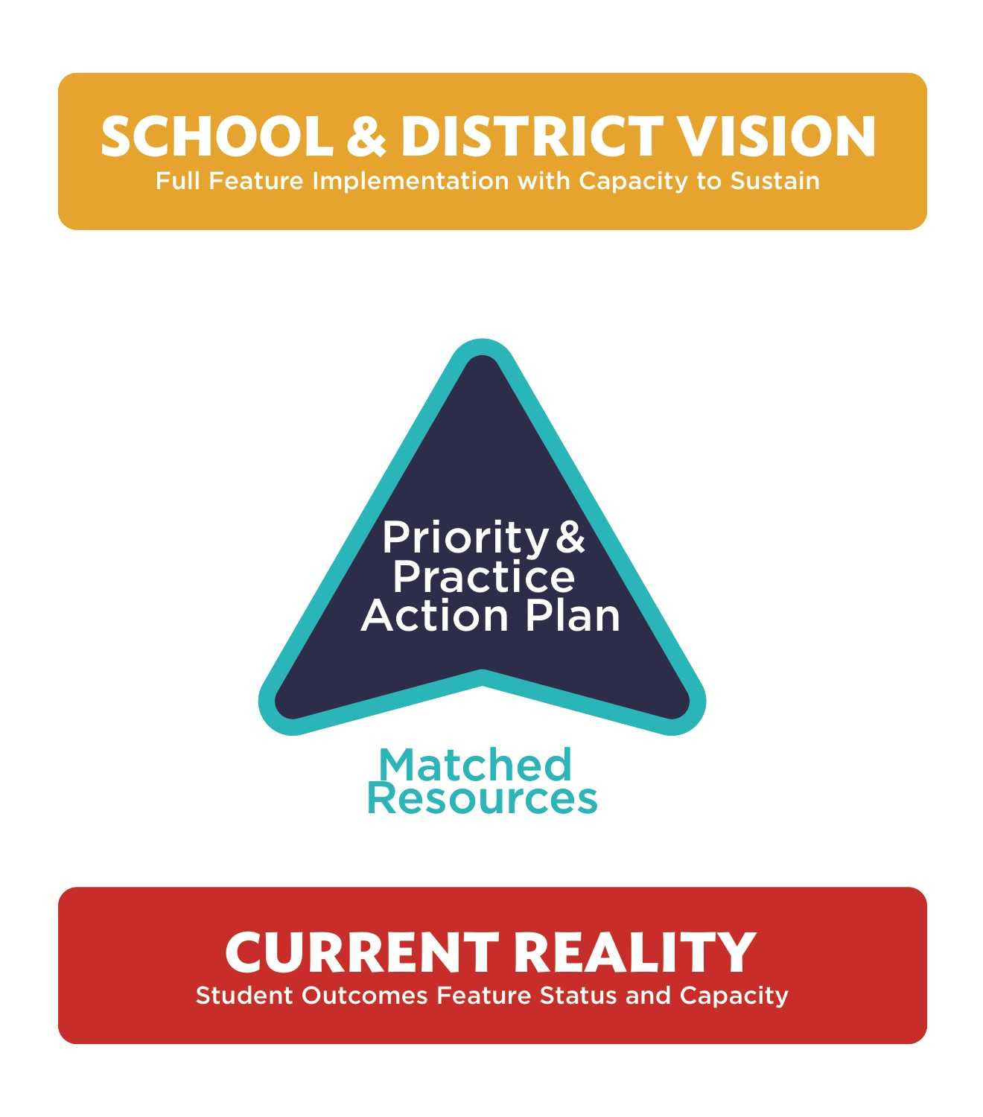




School & District Vision

Slide 5
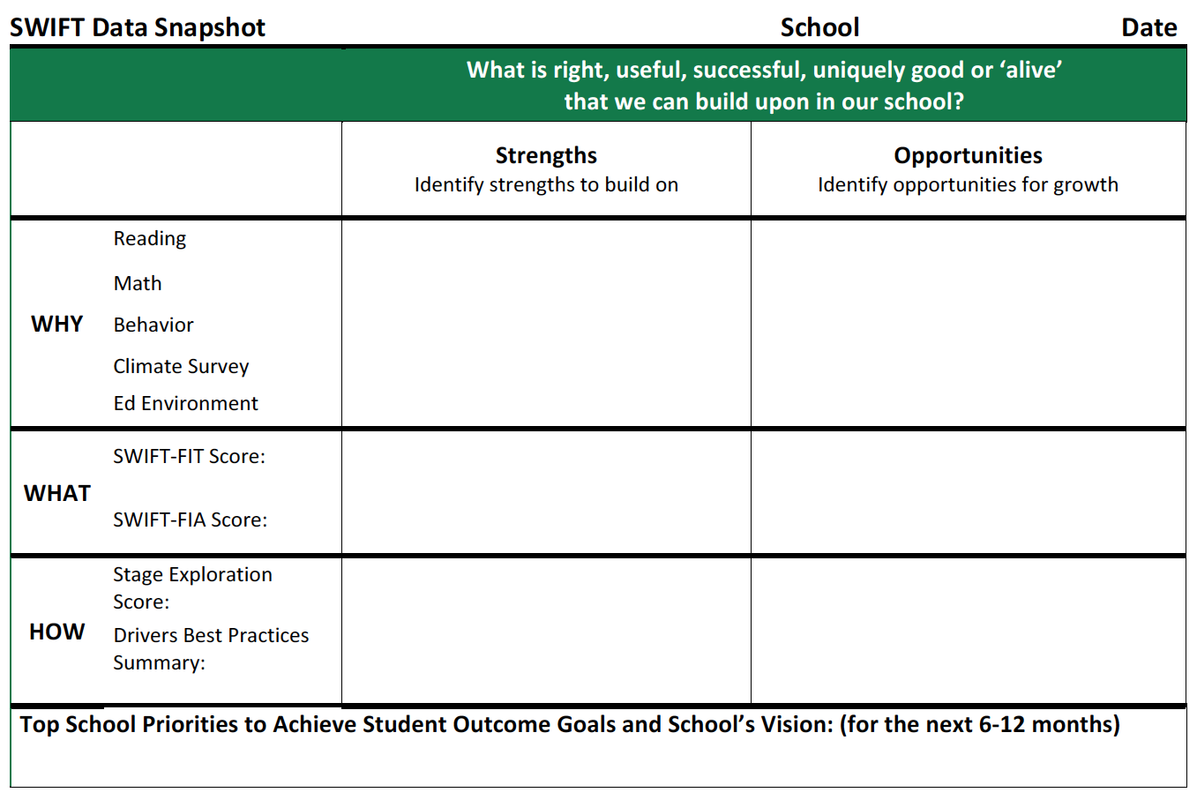
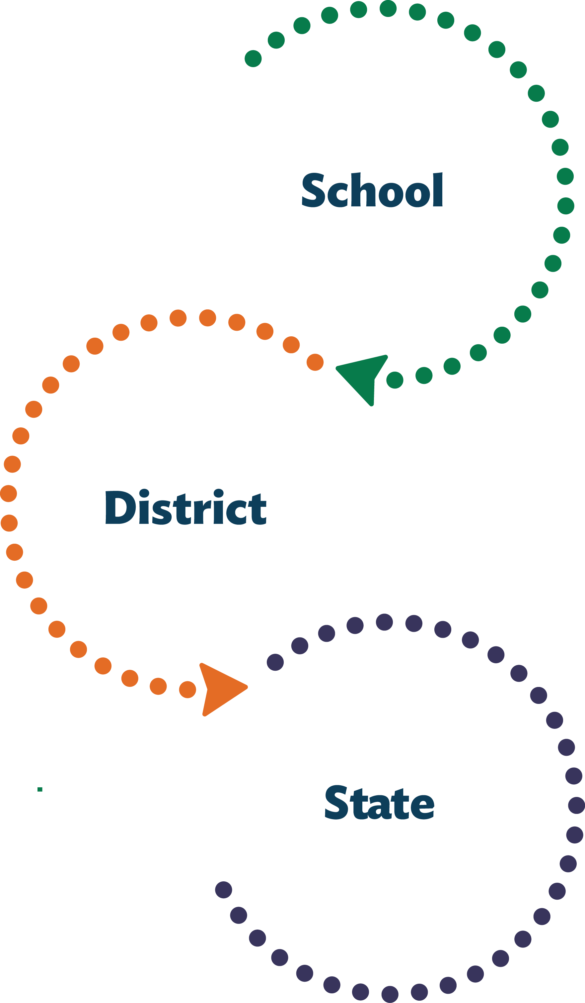
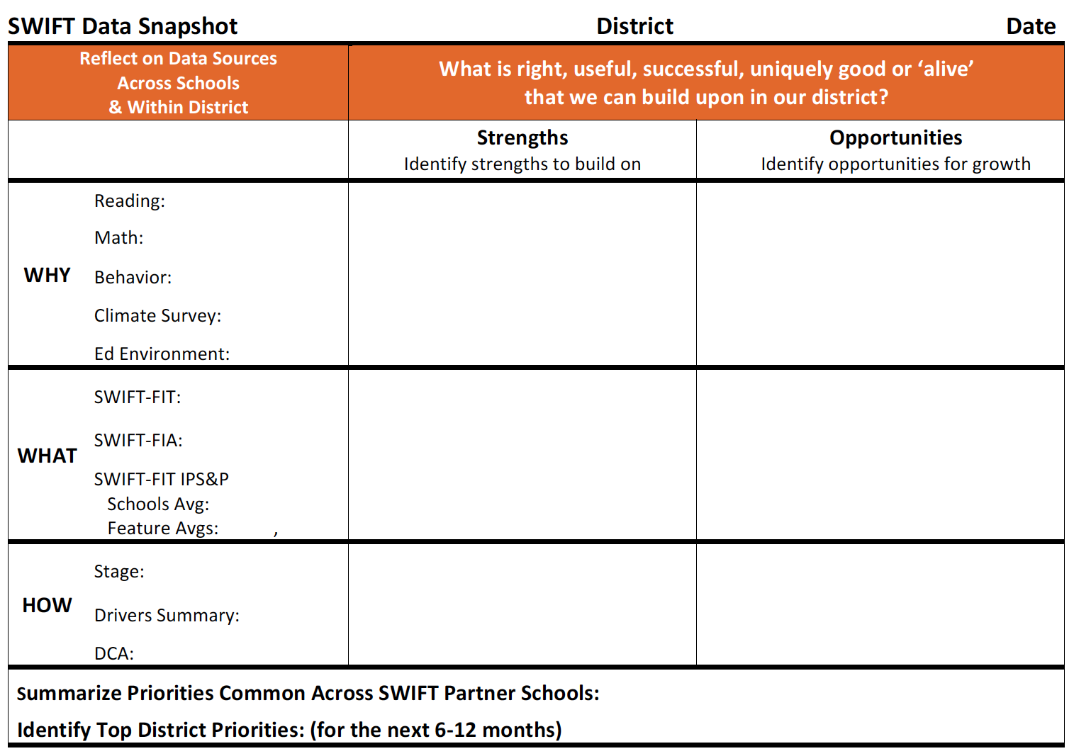
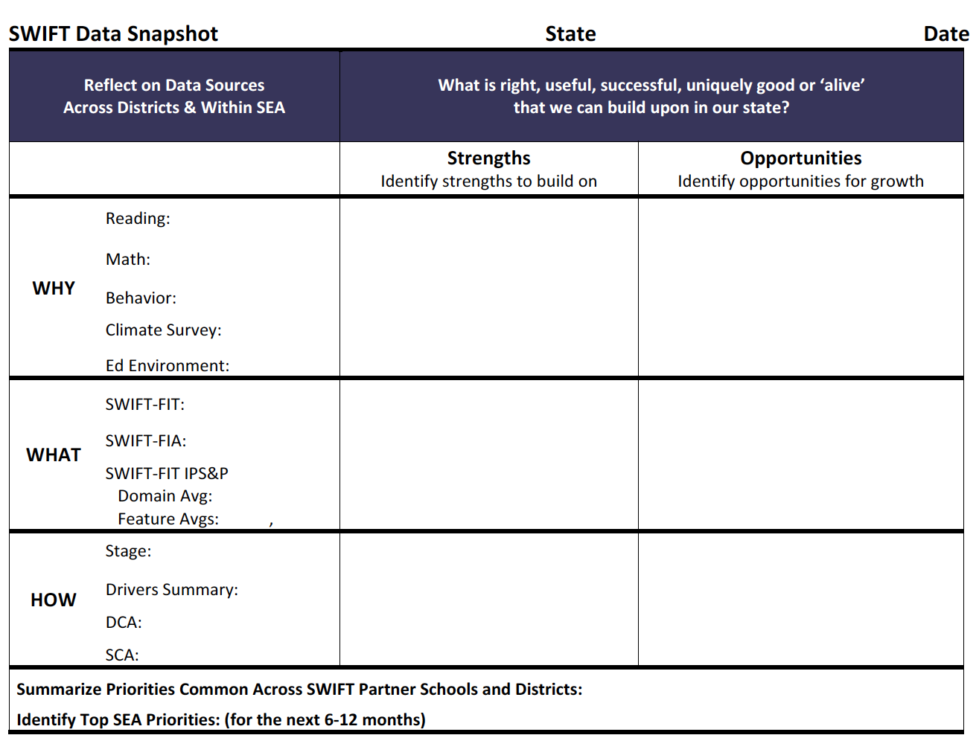
Data Snapshots

Slide 6
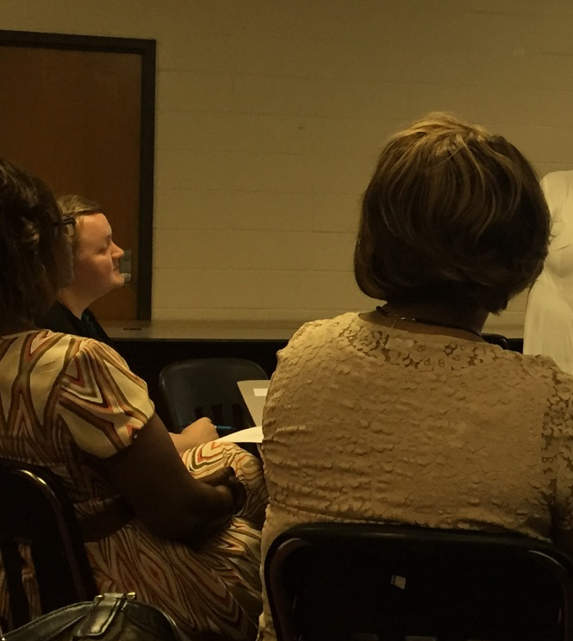
Norms
&
Roles
Notes:
Review Norms:
In what ways do we need to conduct ourselves in order for us to be most productive and engaged in this work?
Review or create roles:
Note Taker
Timekeeper?
Observer?
Jargon buster?

Slide 7
REACH A SHARED UNDERSTANDING OF CURRENT REALITY

Slide 8
CURRENT REALITY
WHY:
Student Outcomes
DATA SNAPSHOTS
Organizing
Our Data
WHAT:
Feature Status
HOW:
Capacity Status

Slide 9
DATA SNAPSHOTS
What Outcome Data Are We Reviewing?
Focus of the Review
Reading
Math
Behavior
Educational Environment
Climate
Lens for the Review
On Track
Change Within Year
Groups of Interest (Gap Analysis)
Notes:
Narrow down you data into key indicators for this conversation –
You may want to focus on a particular goal you want to further that was identified in the SPP –
If you just completed a Literacy Plan, you may choose for your team to focus on math –
You may choose to look at multiple areas simultaneously
Narrow down your data sources that will capture current status, change within the year, and allow for understanding groups of interest - SWD
Want to avoid paralysis by analysis --- too many data sources, for this purpose, may be a distraction

Slide 10
DATA SNAPSHOTS
Facilitating Our Analysis
Elicit and Capture Observations
  Students on track
  Change within year
  Groups of interest
  Climate
  Educational Environment
Notes:
What do we see when we look at the percentage of students on-track over time?
What do we see when we look at the percentage of students with IEP’s on-track over time?
What do we see when we look at change from beginning of the year to the end of the year?
What is noticeable or interesting when looking at grade levels or particular groups of interest?
What do we see when we look at staff, students, and parents perception of our school climate?
What do we see when we look at the percentage of students with IEP’s who spend 80% or more of their day in general education settings?
What do we see when we look at the percentage of students who participate in core (Tier I) reading and math instruction?
What is noticeable or interesting when looking at grade levels or particular groups of interest?

Slide 11
Generating Strengths
& Opportunities
Strengths
Opportunities
Notes:
If a particular analysis needs to be examined, please note for the Facilitator to capture.

Slide 12
DATA SNAPSHOTS
Organizing
Our Data
CURRENT REALITY
WHY:
Student Outcomes
WHAT:
Feature Status
HOW:
Capacity Status

Slide 13
DATA SNAPSHOTS
What Fidelity Data Are We Reviewing?
SWIFT Fidelity of Implementation Tool
(SWIFT-FIT)
SWIFT Feature Integrity Assessment
(SWIFT-FIA)

Slide 14
DATA SNAPSHOTS
Facilitating Our Analysis
Elicit and Capture Observations
  Current status by Feature
  Change in Feature scores over time

Slide 15
Generating Strengths
& Opportunities
Strengths
Opportunities
swiftschools.org
Notes:
If a particular analysis needs to be examined, please note for the Facilitator to capture.

Slide 16
DATA SNAPSHOTS
Organizing
Our Data
CURRENT REALITY
WHY:
Student Outcomes
WHAT:
Feature Status
HOW:
Capacity Status

Slide 17
DATA SNAPSHOTS
What Capacity Data Are We Reviewing?
Stage Exploration Score
Use of Stage-based Planning
Drivers Best Practice Summary

Slide 18
DATA SNAPSHOTS
Facilitating Our Analysis
Elicit and Capture Observations
  Exploration/Foundation self-assessment status and change over time
  Status of capacity in relation to Drivers Best Practices and District Capacity Assessment
  Use of stage-based planning
Notes:
What is the current status of the components included in the Exploration/Foundation Self-Assessment?
What is the current status of our capacity in relation to the Drivers Best Practices?
What do these data tell us about our school’s use of stage-based planning and the drivers of implementation to sustain current practices

Slide 19
Generating Strengths
& Opportunities
Strengths
Opportunities
Notes:
If a particular analysis needs to be examined, please note for the Facilitator to capture.

Slide 20
ESTABLISH STUDENT OUTCOME GOALS

Slide 21
DATA SNAPSHOTS
Student Outcome Goals
Reading
Mathematics
Behavior
Educational Environment

Slide 22
DETERMINE PRIORITIES

Slide 23
Identify Priorities
Review Current Initiatives
Review Vision
Generate Possible Priorities
Set Priorities

Slide 24
SUMMARIZE AND NEXT STEPS

Slide 25
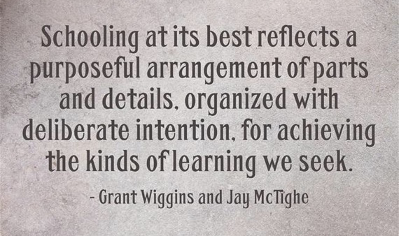
Reflection

Slide 26

Final Slide
SWIFT Center produced this presentation under U.S. Department of Education, Office of Special Education Programs Grant No. H326Y120005. OSEP Project Officers Grace Zamora Durán and Tina Diamond served as the project officers. The views expressed herein do not necessarily represent the positions or policies of the Department of Education. No official endorsement by the U.S. Department of Education of any product, commodity, service or enterprise mentioned in this publication is intended or should be inferred. This product is public domain. Authorization to reproduce it in whole or in part is granted. Please cite as: Presenter, A.A.. (Year, Month). School Data Snapshots. Presented at Organization, Location.

