Slide 1

Site Name
Design
Date

Slide 2
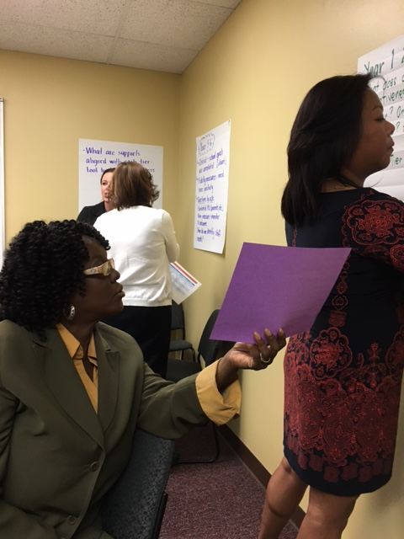

WHY?
DESIGN provides an incentive for all involved by generating a collective agreement about an ideal future education system for all students in a community.
swiftschools.org

Slide 3
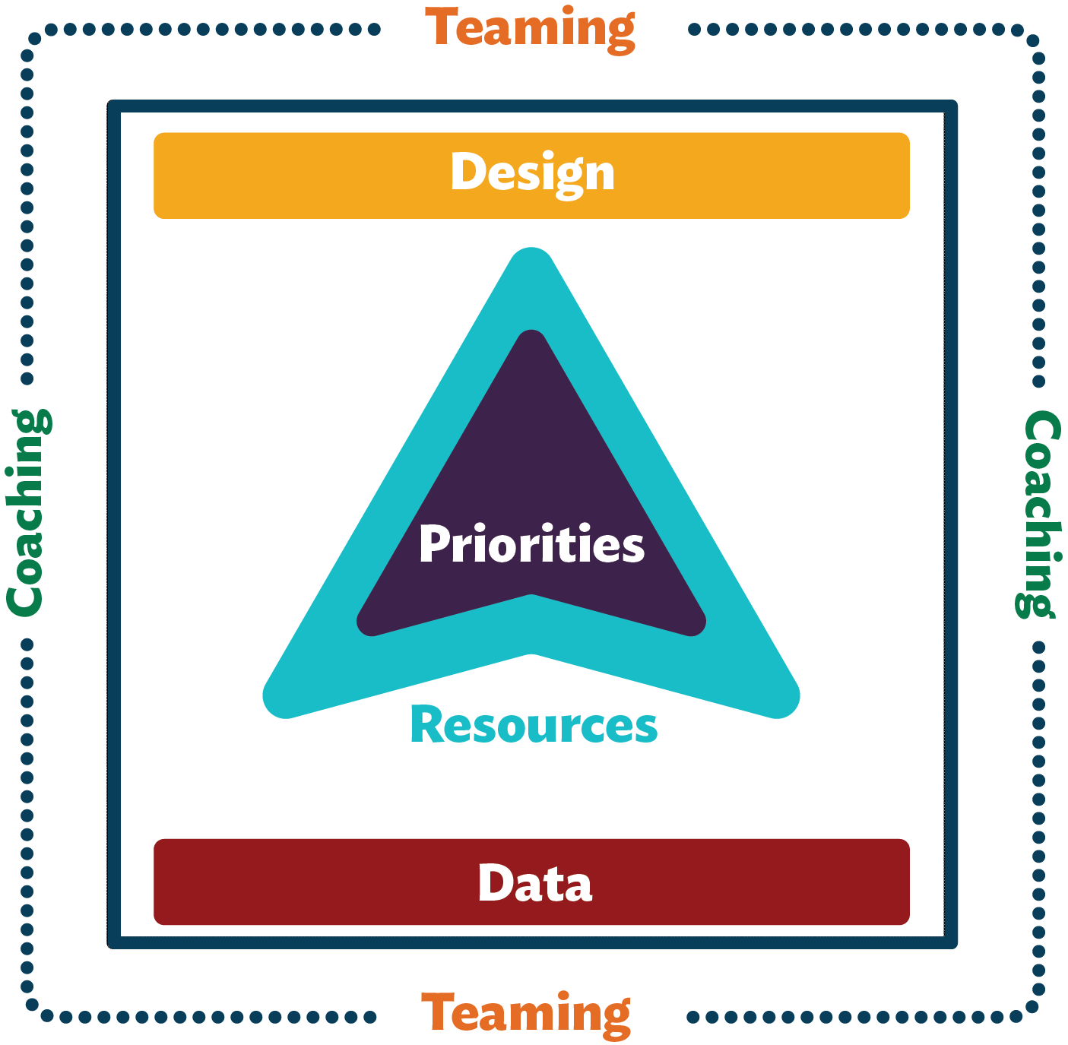
How Do We Design Our Future?
How do we envision ourselves?
swiftschools.org

Slide 4
What does it mean to Design the Future?
CURRENT REALITY
Design the Future
is a strengths-based practice
that generates a collective agreement
about an ideal future education system
for all students within a community.

Slide 5
What We Will Accomplish Together
Plan the Process
Develop & Engage
Dialogue
Agree
swiftschools.org

Slide 6
PLAN THE PROCESS
swiftschools.org

Slide 7
Plan
the
Process
HOW would we like this to proceed?
WHO will be involved and when?
WHEN will we do it?

Slide 8
Plan
the
Process
How?
Who?
When?
 | Develop and Engage | Dialogue | Agree
District Administrators
School Administrators
Educators
Staff
Families
Community Members
Students
CURRENT REALITY

Slide 9
DEVELOP & ENGAGE

Slide 10
Develop Descriptive Statements:
What is your ideal school?
CURRENT REALITY
What would success look like in every class, in every school, every day?
… for students, staff, faculty, administrators, families, and community partners…
What does full implementation of the SWIFT Framework look like for your school?
swiftschools.org

Slide 11


Domains & Features

Slide 12
DIALOGUE

Slide 13
Seek
Clarity
Do I understand what this descriptive statement means?
CURRENT REALITY
What?
Who?
Where?
When?
How?

Slide 14
Determine Agreement
Design Levels of Agreement
I enthusiastically agree.
I agree.
I have minor reservations. I will actively work to get my concerns addressed while supporting us to move ahead. *
I have major reservations. I need specific concerns addressed in order to support moving forward. *
I do not agree. I believe doing so will be detrimental to our school community. *
CURRENT REALITY
* (requires comment)

Slide 15
AGREE

Slide 16
Agreement Process
Develop and Administer the Final Agreement Survey
  Who:
  Timeline:
Summarize and Communicate the Survey Results & Concerns
  Who:
  Timeline:
  How:

Slide 17
Process the Meeting
What worked?
Didn’t work – Enhancements for the Future?

Slide 18

Final Slide
SWIFT Center produced this presentation under U.S. Department of Education, Office of Special Education Programs Grant No. H326Y120005. OSEP Project Officers Grace Zamora Durán and Tina Diamond served as the project officers. The views expressed herein do not necessarily represent the positions or policies of the Department of Education. No official endorsement by the U.S. Department of Education of any product, commodity, service or enterprise mentioned in this publication is intended or should be inferred. This product is public domain. Authorization to reproduce it in whole or in part is granted. Please cite as: Presenter, A.A.. (Year, Month). Visioning. Presented at Organization, Location.

